Slide 1
Final Year Project: Week 5 of 20
Marij Qureshi 16th Jan 2020
Robust Optimisation of Composite Panels

Slide 2
Progress this week
6x Isight tutorials (beam buckling, elastic band response, drain cover optimisation, cylinder buckling)
Understanding and application of surrogate modelling
Completed deterministic study for plate with hole

Slide 3
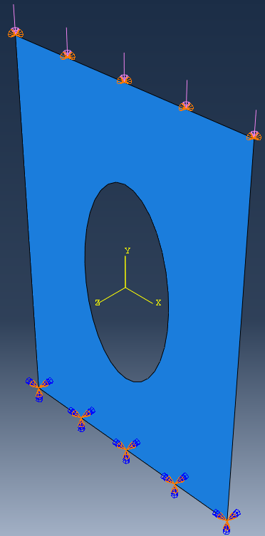
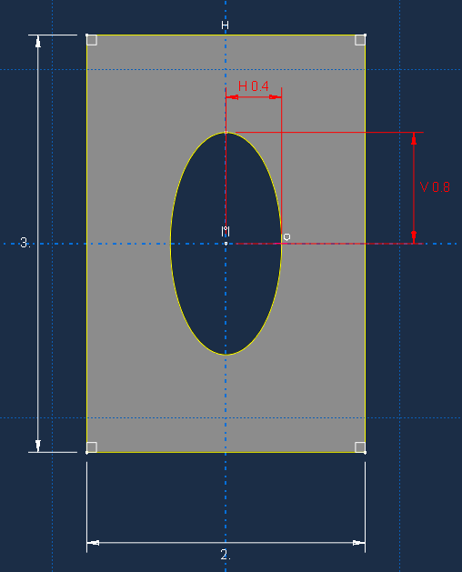
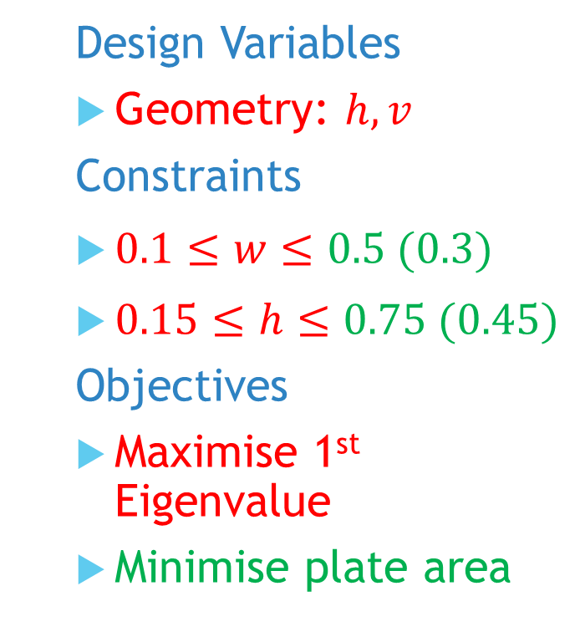
Model
Design Variables
Geometry: $h,v$
Constraints
$0.1≤w≤0.5 (0.3)$
$0.15≤h≤0.75 (0.45)$
Objectives
Maximise 1st Eigenvalue
Minimise plate area
Notes:
Post-buckling reliability design (vary lay-up)
Chapter 7: Robust Multilevel Design Optimization of Composite Panels
Robust and Reliability-Based Design Optimization of a Composite Floor Beam

Slide 4
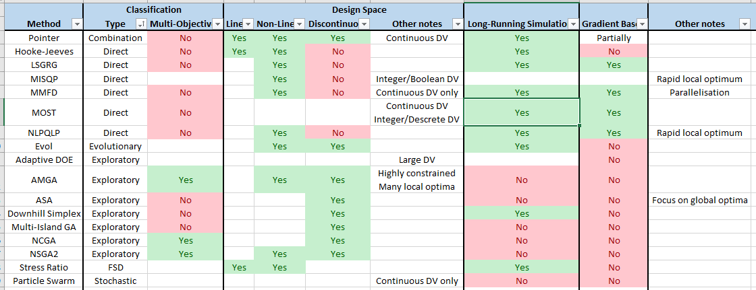
Optimisation Algorithms

Slide 5
Optimisation Algorithms
 | Gradient | Direct | Exploratory | Genetic Algorithm | Combined
Single-Objective | NLPQLP MMFD LSGRG MISQP | Hooke-Jeeves Downhill Simplex | ASA MIGA |  | MOST POINTER
Multi-Objective |  | Stress-Ratio | Particle Swarm Evol Adaptive DOE | NSGA2 NCGA AMGA

Slide 6
Deterministic Study

Slide 7
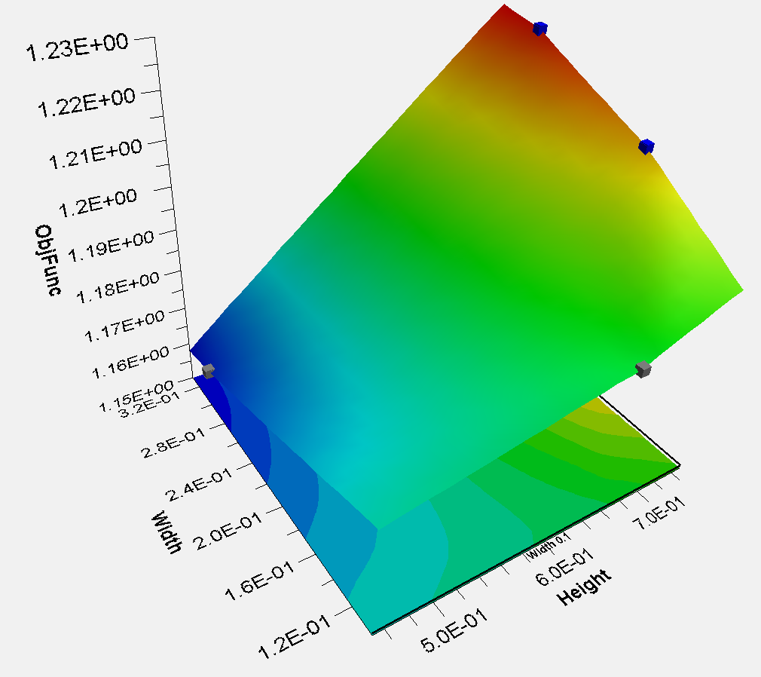
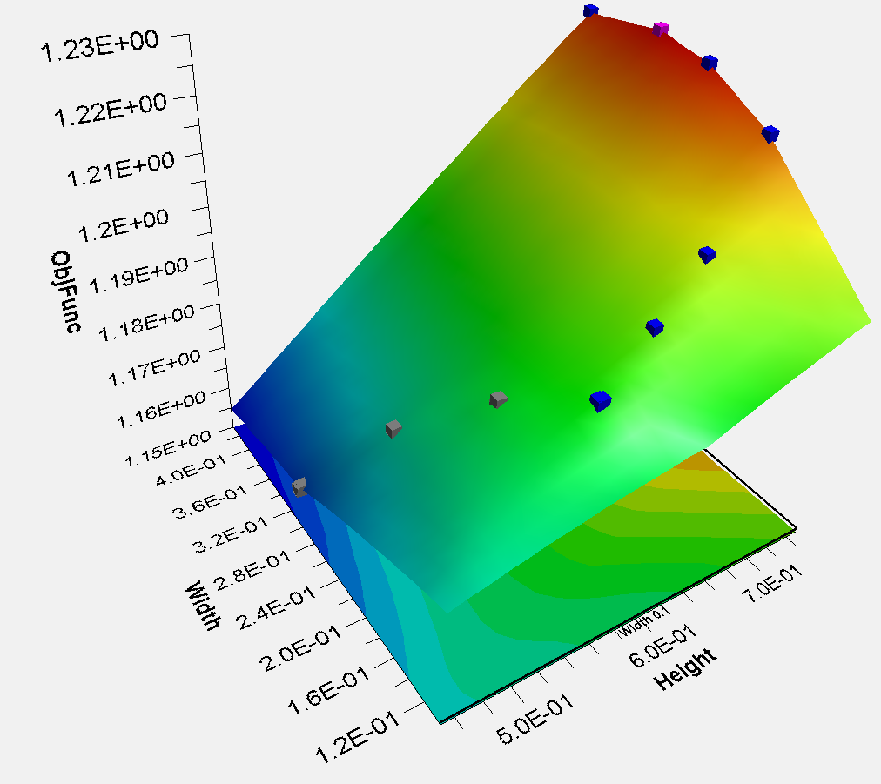
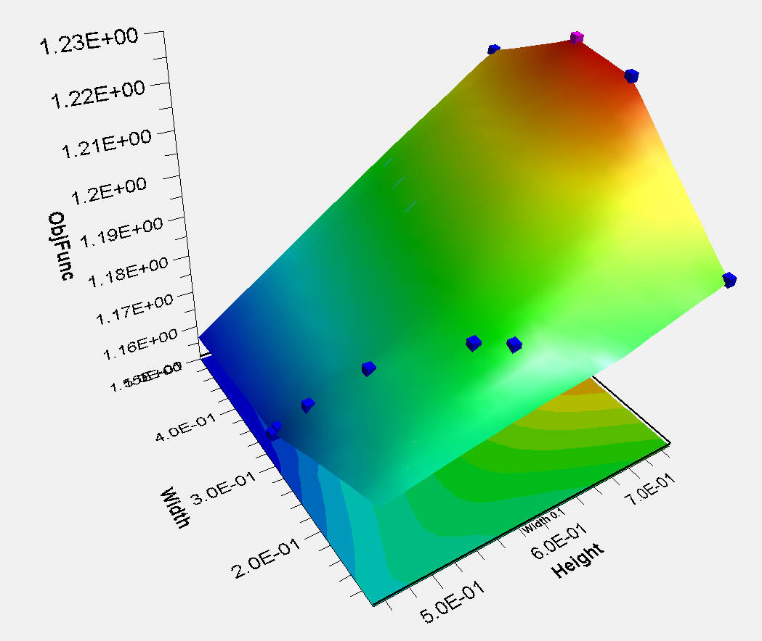
Gradient Methods
Sequential Quadratic Programming
Modified Method of Feasible Directions
Large Scale Generalized Reduced Gradient

Slide 8
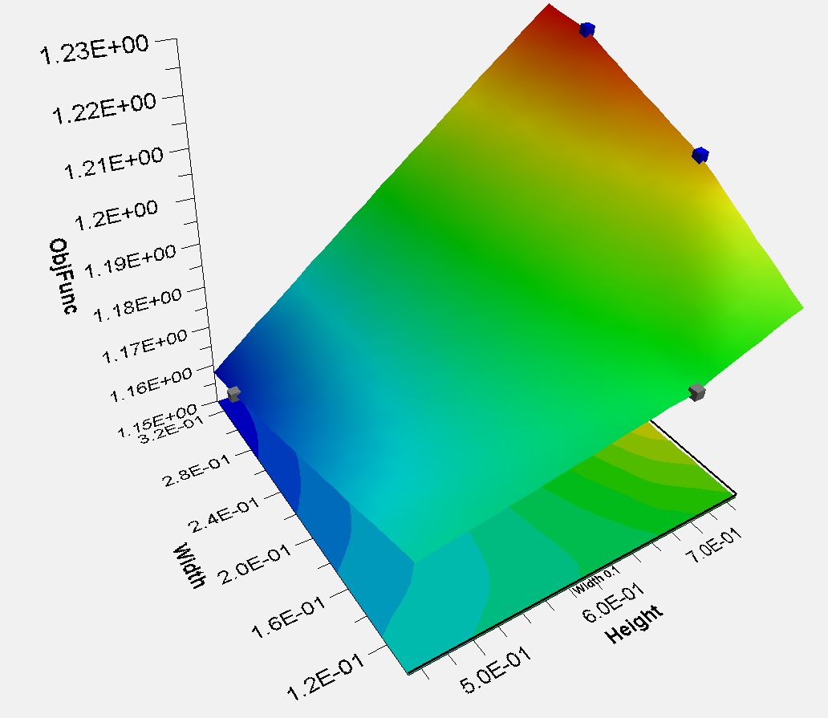
Gradient Methods
Mixed Integer Sequential Quadratic Programming

Slide 9
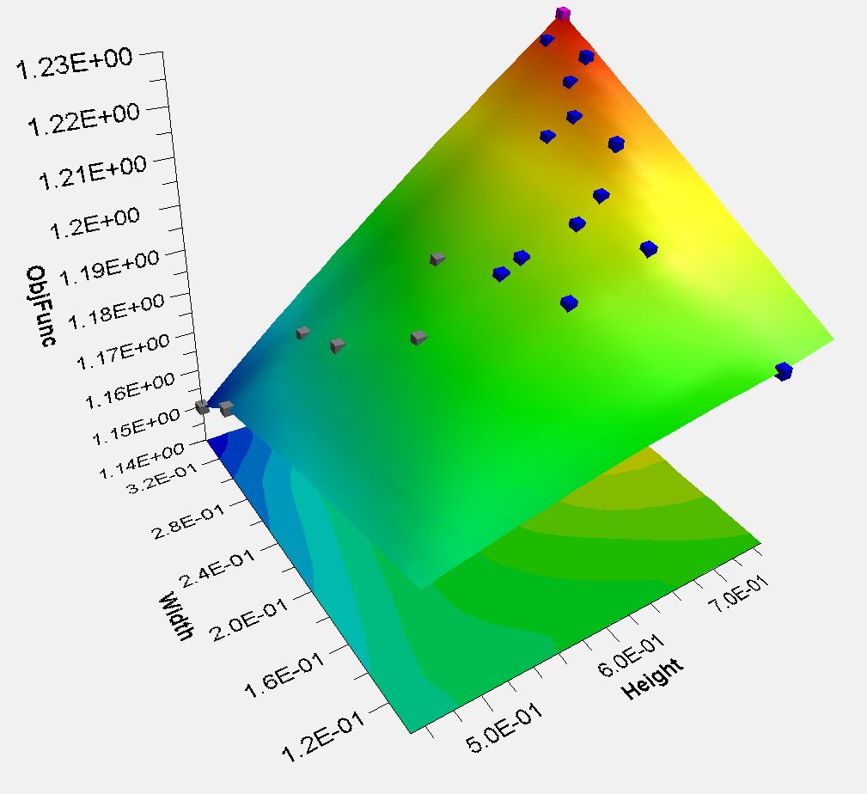
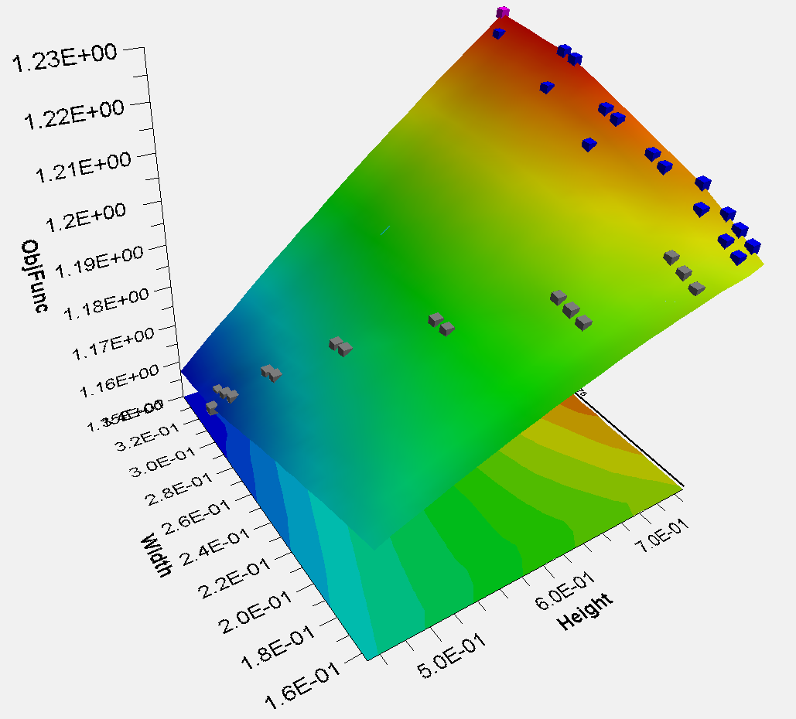
Direct Methods
Downhill Simplex
Hooke-Jeeves Direct Search

Slide 10
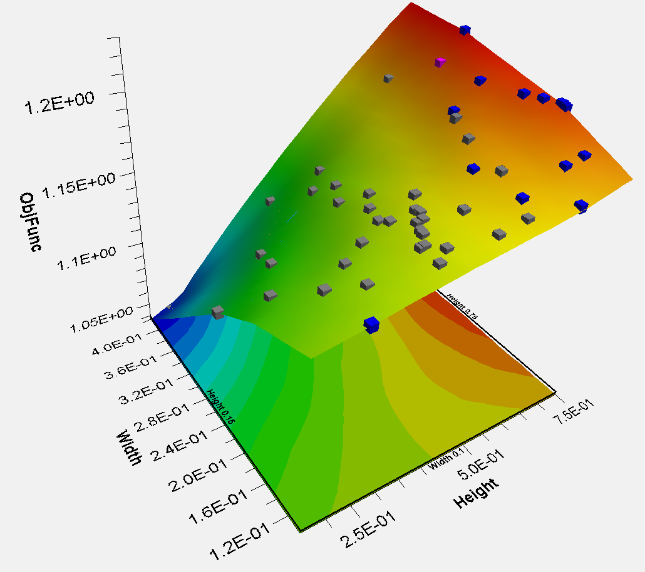
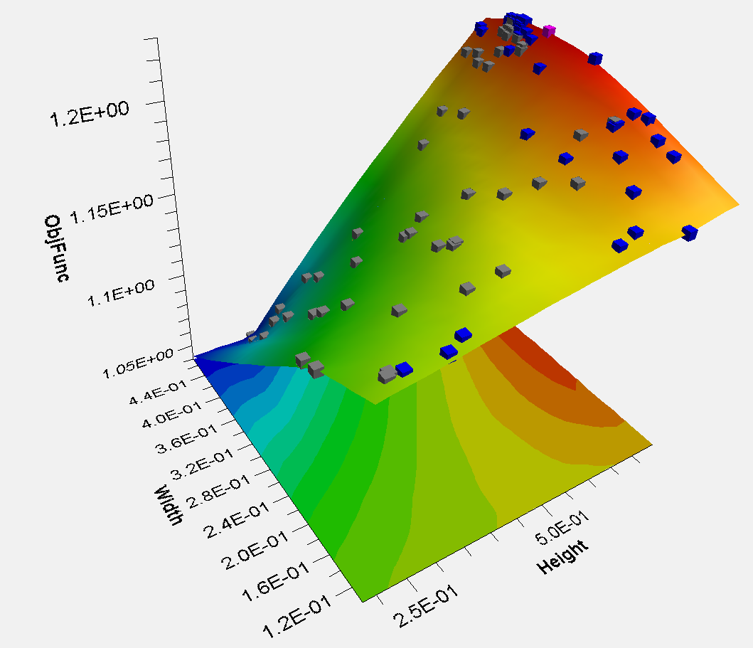
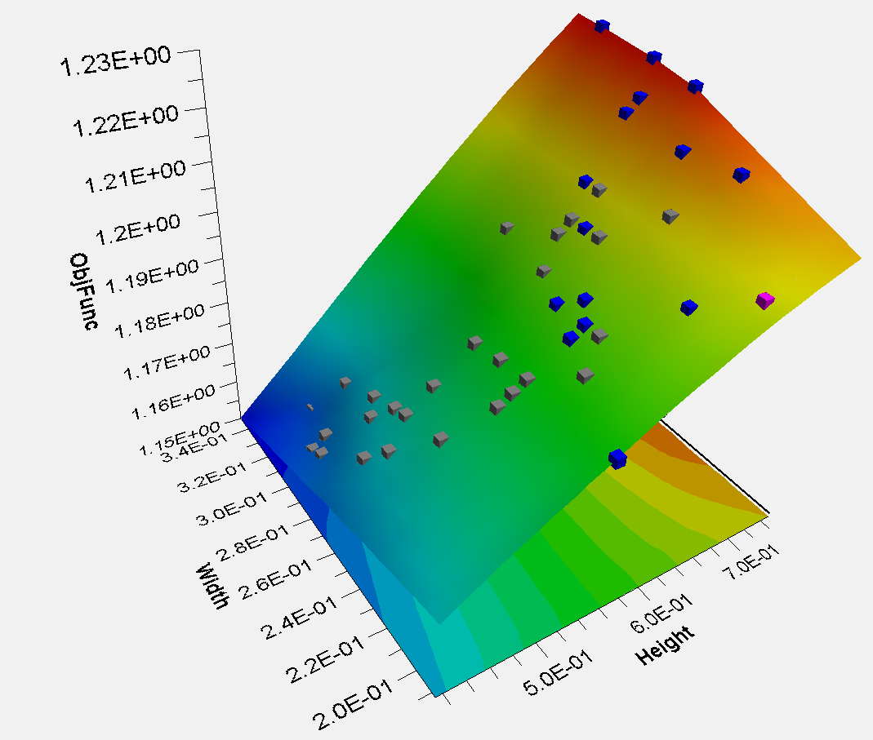
Exploratory Methods
Evolutionary Optimization Algorithm
Multi-Objective Particle Swarm Optimization
Adaptive simulated annealing

Slide 11
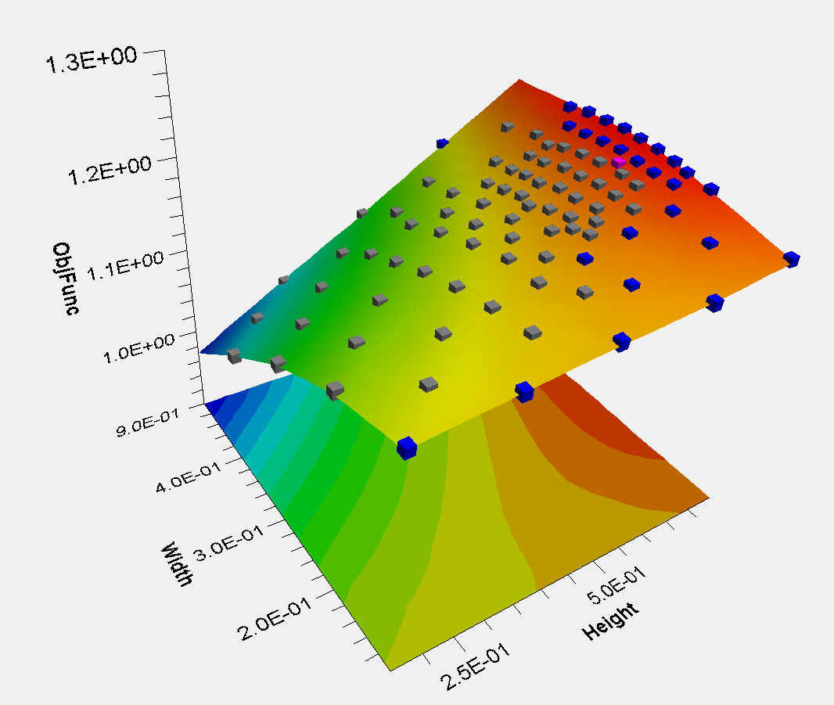
Exploratory Methods
Adaptive Design of Experiments

Slide 12
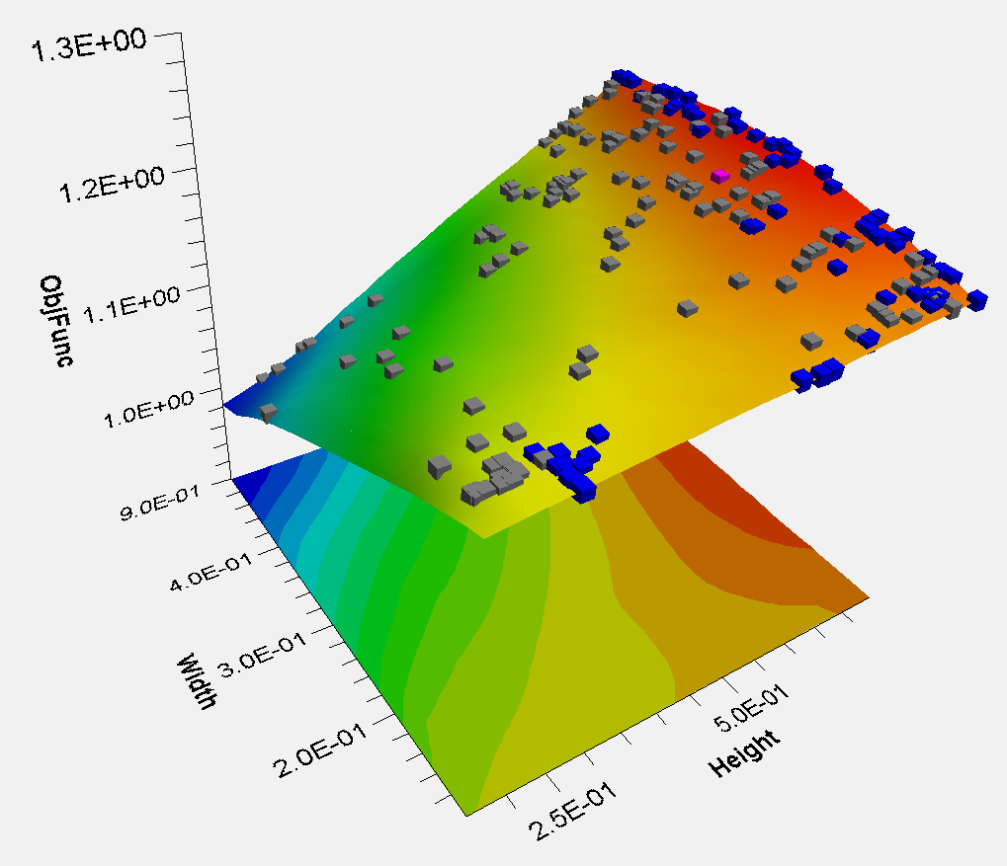
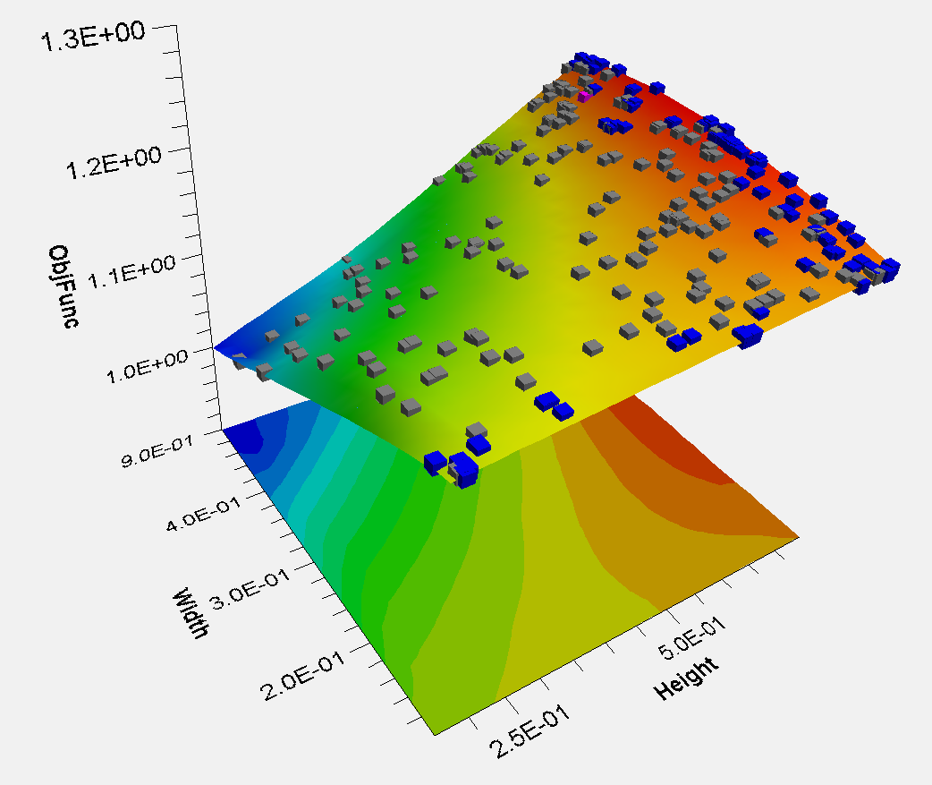
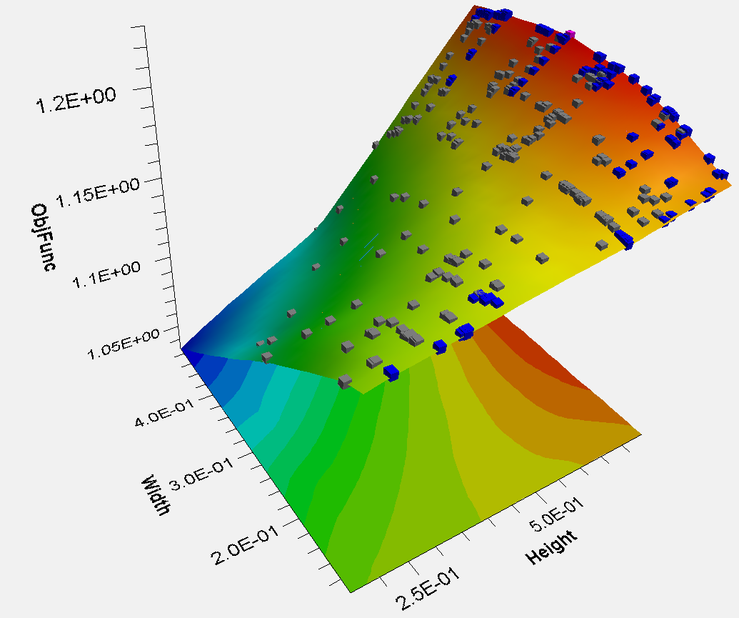
Genetic Algoritm Methods
Non-dominated Sorting Genetic Algorithm
Archive based Micro Genetic Algorithm
Neighbourhood Cultivation Genetic Algorithm

Slide 13
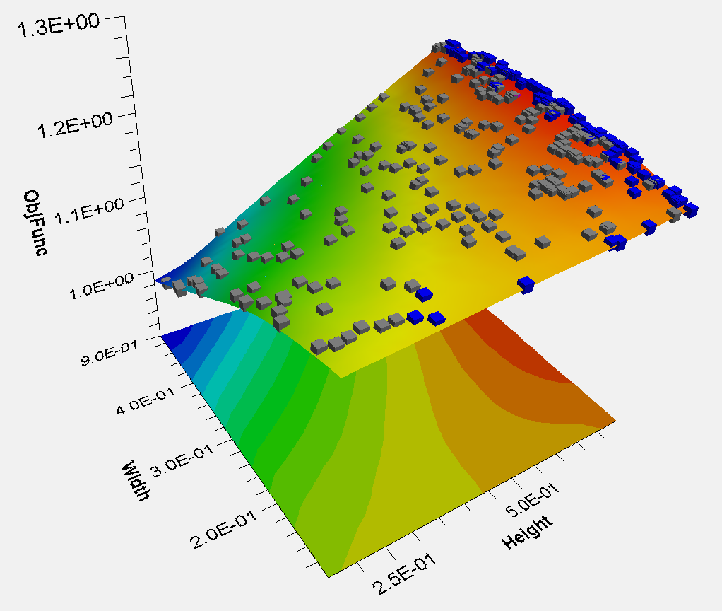
Genetic Algorithm Methods
Multi-Island Genetic Algorithm

Slide 14
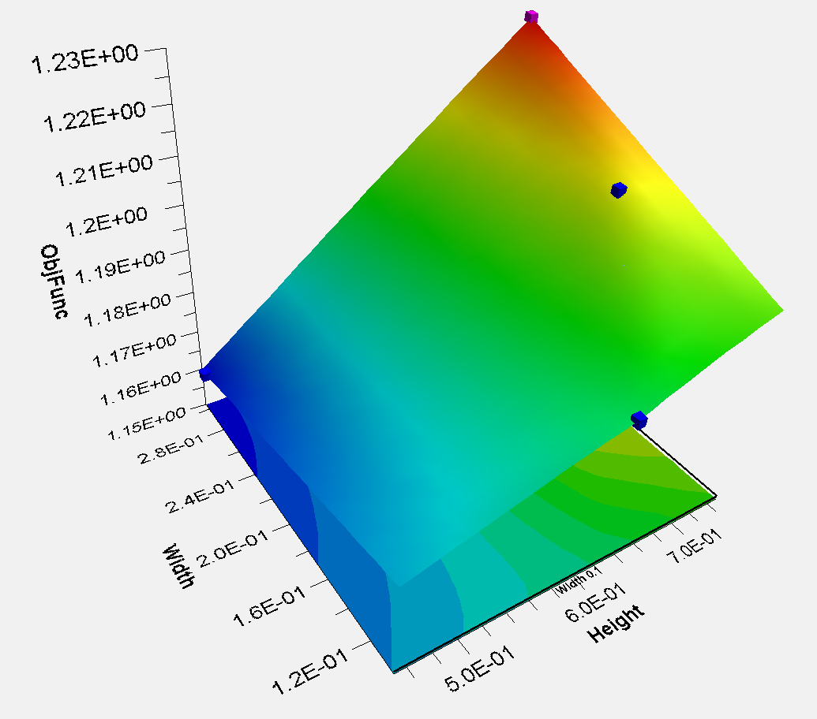
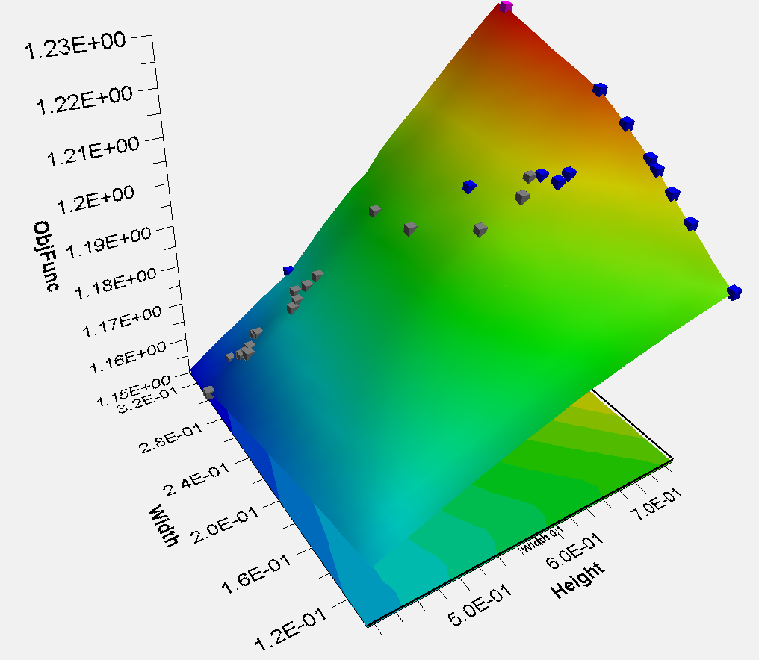
Combined Methods
Multifunction Optimization System Tool
Pointer Automatic Optimizer

Slide 15
Optimisation Algorithms
 | Gradient | Direct | Exploratory | Genetic Algorithm | Combined
Single-Objective | NLPQLP MMFD LSGRG MISQP | Hooke-Jeeves Downhill Simplex | ASA MIGA |  | MOST POINTER
Multi-Objective |  |  | Particle Swarm Evol Adaptive DOE | NSGA2 NCGA AMGA

Slide 16
Next Steps
Composite lay-up
Model Refinement
Further algorithm parameter tuning (GA)

Slide 17
Project plan
Workflow Test Case
Main Test Case
Design Studies
Computation
Final Report Work
Design Study Flow / Test Problem
Optimisation Methods
Results Analysis
Analytical Work + Research
Wks 17-19
Wks 1-3
Wks 4-7
Wks 9-16
Week | 1 | 2 | 3 | 4 | 5 | 6 | 7 | 8 | 9 | 10 | 11 | 12 | 13 | 14 | 15 | 16 | 17 | 18 | 19
Month | Jan |  | Feb |  |  |  | Mar |  |  |  |  | Apr |  |  |  | May

Slide 18
Questions
Nonlinearity
Complexity ceiling
Other useful problems

